Slide 1
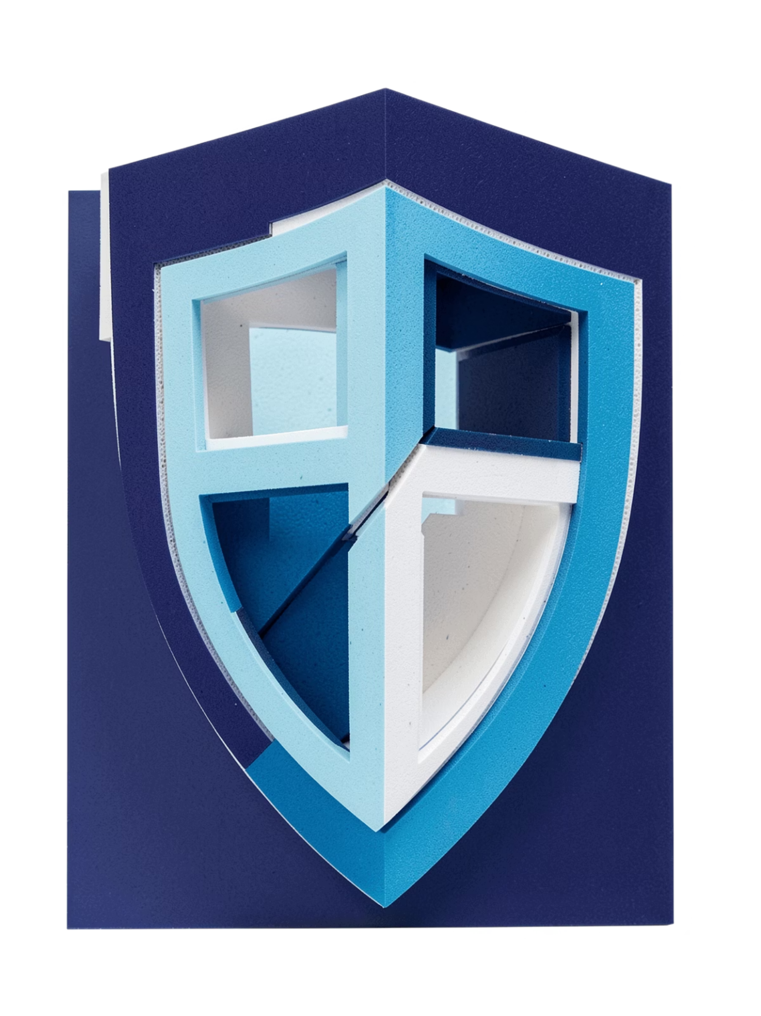
Cyber Hygiene
Your Digital Health Depends
on Your Daily Habits
Cyber Hygiene
Would you leave your house unlocked every day?
Then why leave your digital life unprotected?

Slide 2
What is Cyber Hygiene?
Cyber Hygiene
Cyber hygiene is the set of everyday habits that keep your devices, accounts, data, and your online identity secure.
Your Digital Health Depends
on Your Daily Habits
Would you leave your house unlocked every day?
Then why leave your digital life unprotected?
Physical analogy
Clean hands → fewer germs
Digital analogy
Secure habits → fewer cyber risks
Cyber Hygiene

Slide 3
Cyber Hygiene
What is Cyber Hygiene?
Cyber hygiene is the set of everyday habits that keep your devices, accounts, data, and your online identity secure.
Your Digital Health Depends
on Your Daily Habits
Physical analogy
Would you leave your house unlocked every day?
Then why leave your digital life unprotected?
Clean hands → fewer germs
Digital analogy
Secure habits → fewer cyber risks

Slide 4
Why It Matters
Attackers target ordinary people because everyday accounts unlock valuable data.
One compromise can cascade across your life.

Slide 5

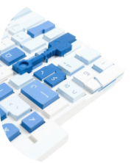
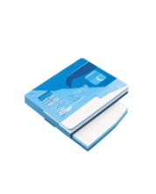
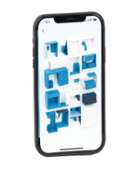
Why It Matters
Attackers target ordinary people because everyday accounts unlock valuable data.
One compromise can cascade across your life.
Personal accounts
Passwords & credentials
Financial info
Photos & documents
Banking and payment apps are high-value targets.
Social, email — entry points for identity theft.
Reused passwords let attackers hop between accounts.
Personal data can be leaked or misused.

Slide 6
The 5 Golden Rules

Slide 7
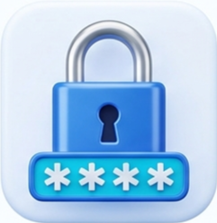
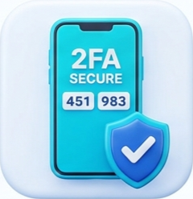



The 5 Golden Rules
1. Strong, unique passwords
2. Enable 2‑factor authentication
3. Keep software updated
4. Think before clicking
Use a passphrase or password manager — no repeats.
Add an extra layer: authenticator or security key.
Install updates to patch vulnerabilities.
Pause, verify sender and links before acting.
Strong, Unique
Passwords
Enable 2Factor
Authentication
Keep Software
Updated
Think before clicking
Back-up your
Important Data
5. Back up important data
Keep copies offline or in a trusted cloud.

Slide 8

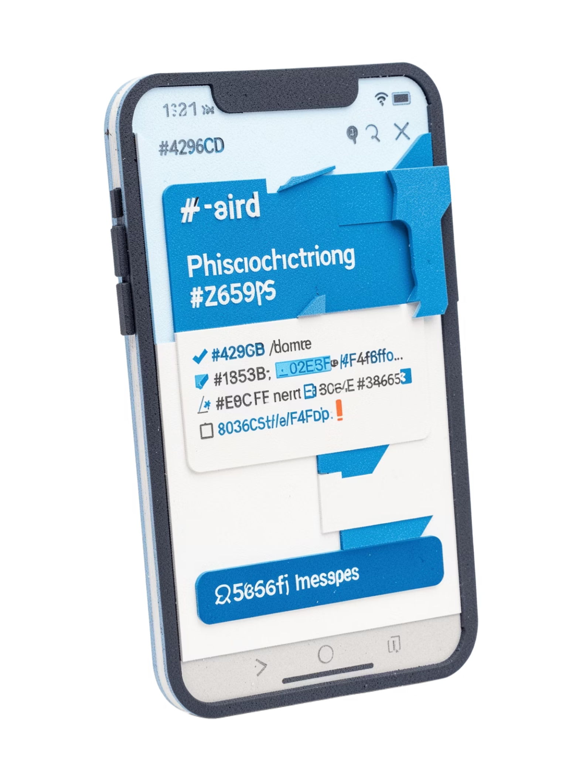
Phishing:
Fictional example: "URGENT! Your account will be permanently deleted today. Click here immediately."
Warning signs
Click without checking
Stop + Verify
Urgency or threats
Suspicious links or domains
Requests for passwords or OTPs
→ Possible credential theft and account compromise
→ Check sender, URL, and contact the service directly

Slide 9
Phishing:
Fictional example: "URGENT! Your account will be permanently deleted today. Click here immediately."
Click without checking
Stop + Verify
→ Possible credential theft and account compromise
→ Check sender, URL, and contact the service directly
Warning signs
Urgency or threats
Suspicious links or domains
Requests for passwords or OTPs

Slide 10
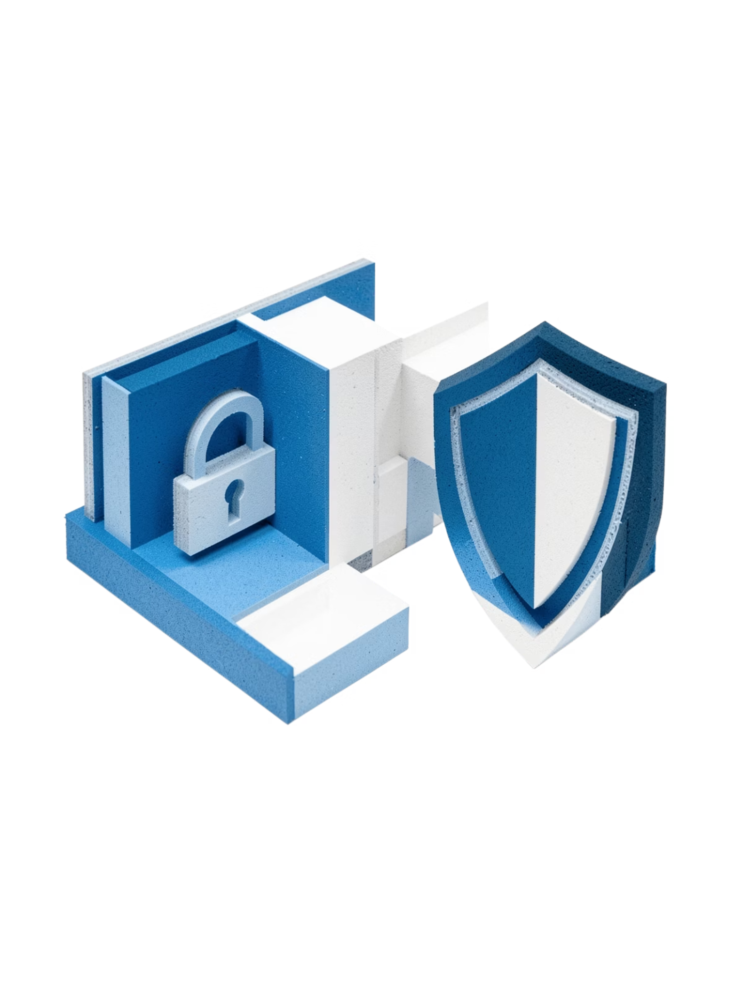
Passwords & 2FA
Passwords alone can fail. Add 2FA to keep attackers out even if credentials leak.

Slide 11
Passwords & 2FA
Passwords alone can fail. Add 2FA to keep attackers out even if credentials leak.
Weak password
🔓 Easy to crack or reuse — risky
Strong unique password
🔐 Longer, unique, stored in a password manager
Strong password + 2FA
🛡️ Authenticator app, security key, or biometrics

Slide 12
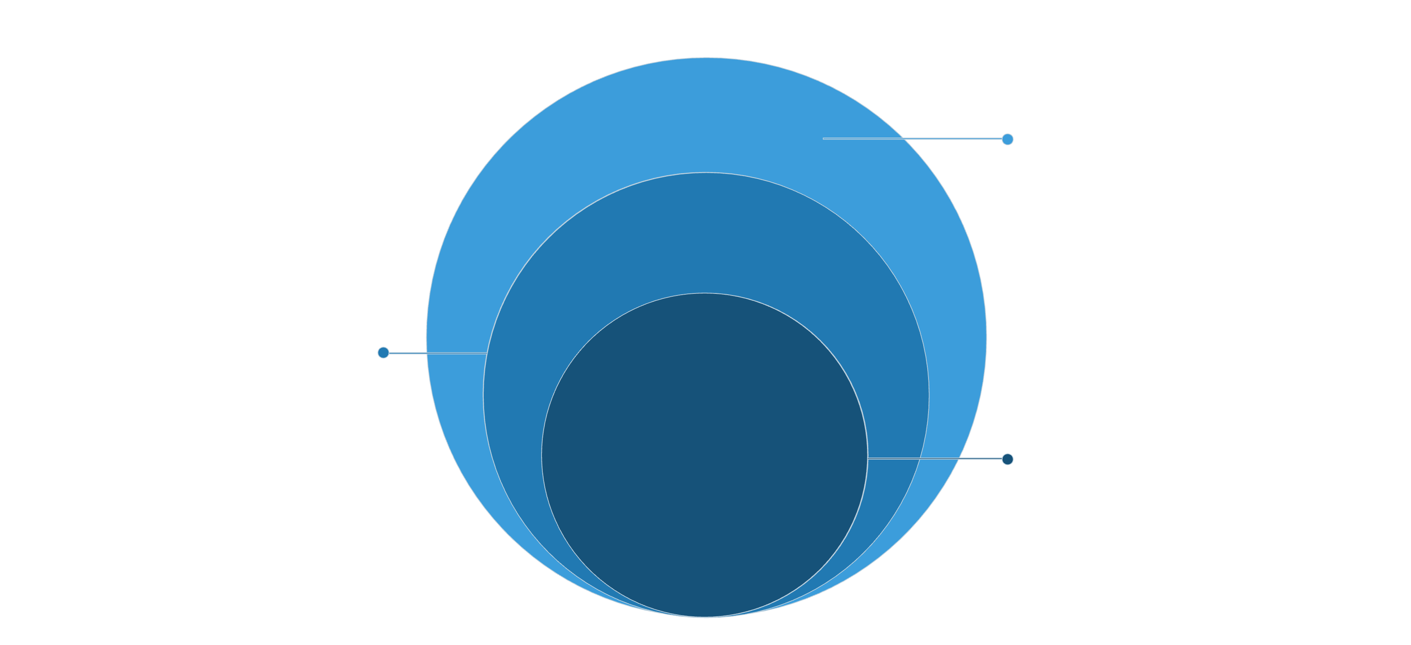
Your Cyber Hygiene Routine
Monthly Review
Update software, review passwords, check privacy settings
Weekly Tasks
Check activity, remove suspicious apps/sessions, back up files
Daily Habits
Think before clicking, lock device, don't share OTPs
1
2
3
Daily
Weekly
Monthly
Think before clicking • Lock device • Don't share OTPs
Check account activity • Remove suspicious sessions/apps • Back up important files
Install updates • Review passwords • Audit privacy settings

Slide 13

SECURITY IS A HABIT, NOT A ONE-TIME SETTING.
🔐 Strong passwords
🛡️ 2FA
🔄 Updates
🎣 Phishing awareness
💾 Backups
Think before you click. Protect before you regret.
Good cyber hygiene doesn't make you impossible to attack. It makes you much harder to compromise.

Slide 14
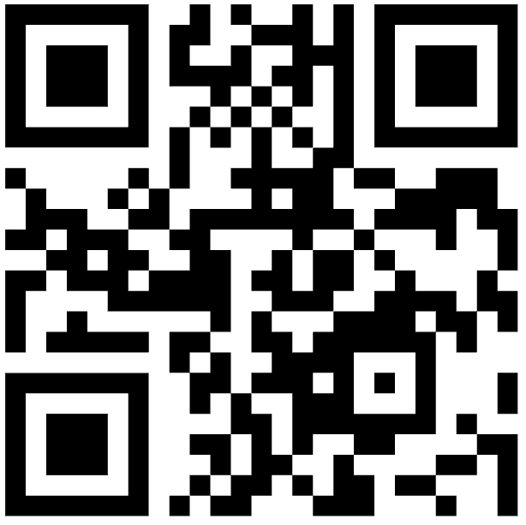
Thank You
Please fill this Google Form.
https://forms.gle/x1AyVPqHUZbGxZFv8

